Slide 1
Spatial Data Science and R
Jay Maxwell, Data Analyst, ISU Extension and Outreach
Christopher Seeger,

Slide 2
R + Data Science + GIS
Data request from Chris:
“A shapefile of the last 3 decennial population counts for all cities in Iowa.”
shapefile
R Script:
Get population counts
Get linework
Join linework and population counts
Output to shapefile and/or .gdb
Visualize joined data
Census Server
gdb

Slide 3

Data Science + R + GIS
Agenda:
Example
Installing R / Using Posit Cloud
Interface Tour
Coding Break
Tidyverse
Simple Features
Coding Break
R + esri
R + QGIS
Code Demo
Questions
Image: https://www.opensourceforu.com/

Slide 4
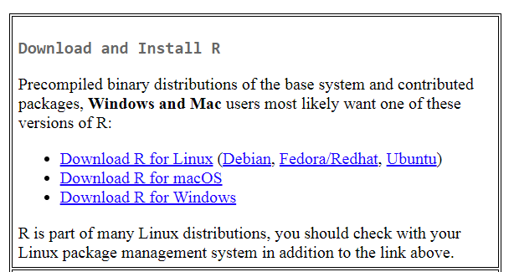
Installing R and R Studio
Install R
https://cran.r-project.org/

Slide 5
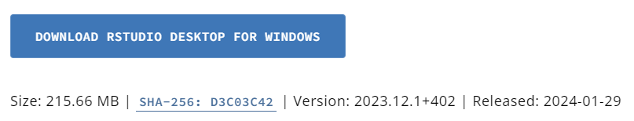
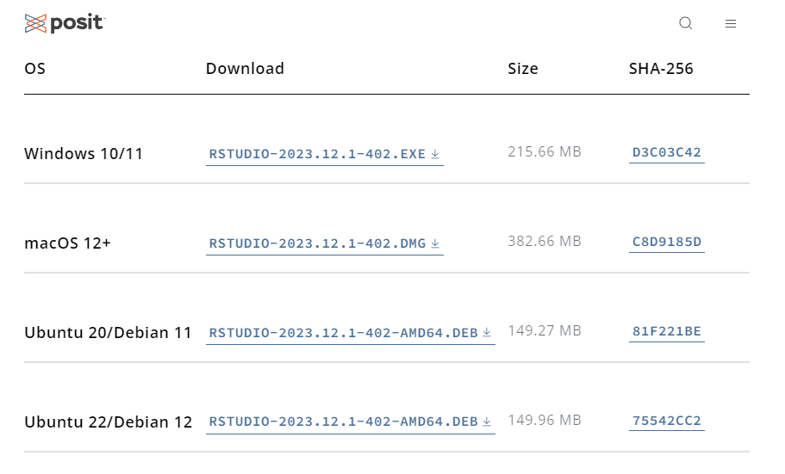
Installing R and R Studio
Install RStudio
https://posit.co/download/ rstudio-desktop/

Slide 6

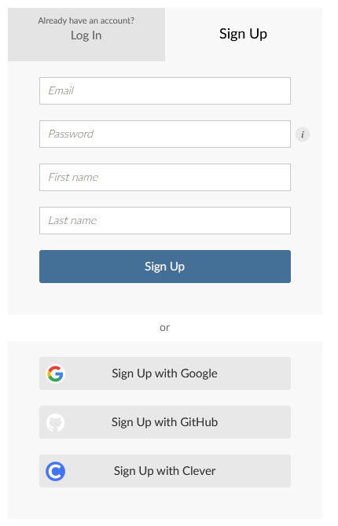
Installing R and R Studio
We have a shared workspace on Posit Cloud for today’s session.
Create an account and log in.
Workspace link will be shared soon!

Slide 7
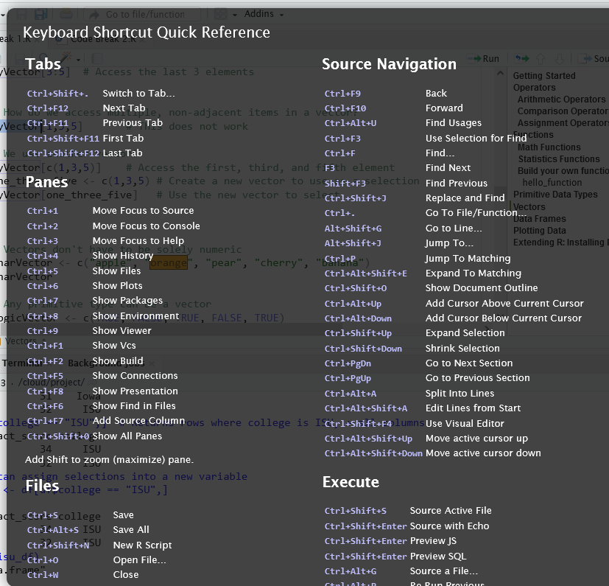
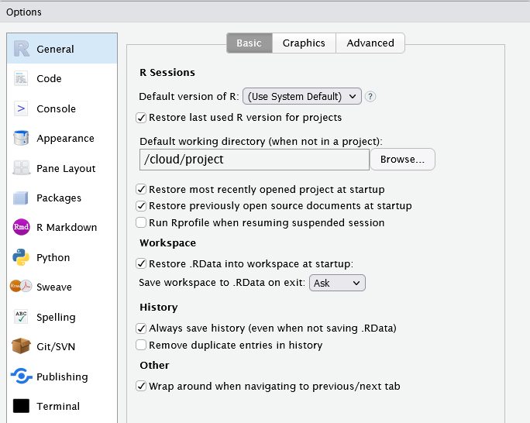
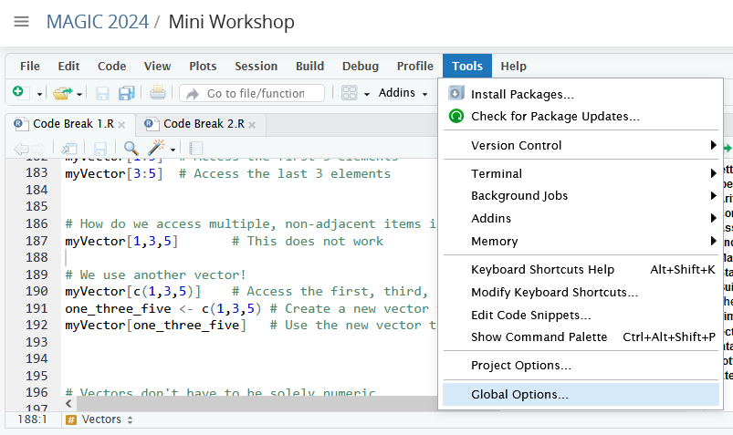
Rstudio / Posit Cloud Tour
All the features of the Desktop application using a browser.
Customize the application via Tools → Global Options
Alt-Shift-K for keyboard shortcut quick reference.

Slide 8
Rstudio / Posit Cloud Tour
Four Panel Interface
Top Left: Scripts
Top Right: Environment, History
Bottom Left: Console, Terminal
Bottom Right: Files, Plots, Packages, Help
Pane and tab locations are fully customizable!

Slide 9
Rstudio / Posit Cloud Tour
Scripts Tab
Can have multiple tabs open
Outline view produced by labeling code sections
Run individual lines, blocks, entire file

Slide 10
Rstudio / Posit Cloud Tour
Environment Tab
Shows objects in workspace memory
Can clear all or selected objects from memory
History Tab
A running list of all commands issued

Slide 11
Rstudio / Posit Cloud Tour
Console Tab
Directly execute R commands
Displays R output
Access R’s help system
Terminal Tab
Execute terminal commands from RStudio

Slide 12
Rstudio / Posit Cloud Tour
Files Tab
In-application file-browser
Plots Tab
Display area for graphic output
Packages Tab
GUI for package management
Help Tab
Display help system documents
Viewer & Presentation Tabs
Display special content

Slide 13
Code Break 1
Create a free account on Posit cloud https://posit.cloud
Then, follow this link to access our workspace
https://go.iastate.edu/TTOFQA
(This server will only be available during this session.)
Alternate: Download R & RStudio to your laptop Download workshop data from GitHub: https://github.com/ISUEOGTP/MAGIC2024

Slide 14
R for Data Science
Covers more than we can during a short workshop at a conference.
The author is a key developer of Tidyverse packages.
Online book is FREE!
https://r4ds.hadley.nz/

Slide 15

The Tidyverse
A collection of integrated packages with a consistent syntax designed for data science.
install.packages(“tidyverse”)

Slide 16
The Tidyverse
library(tidyverse)
Loads 9 “core” packages at once (they can be loaded singly to save resources)
ggplot – Visualize data with plots and charts
tibble – An updated data frame object
tidyr – Reshape data frame (pivot_wider, pivot_longer)
readr – Reads data from a variety of delimited files
purrr – A set of tools for Functional Programming
dplyr – Tools for data maninpulation (filter, mutate, select)
stringr – A set of functions for manipulating text
forcats – Tools for working with factors (categorical variables)
lubridate – Straightforward functions for parsing date strings

Slide 17
The Tidyverse
output <- function_2(function_1(data))
output <- data %>% function_1() %>% function_2()
The pipe operator links together multiple tools by allowing the output of one tool to be the input of the next tool. (Similar to ArcGIS Pro ModelBuilder.)
Both statements above are equivalent.
Makes code more readable.
So useful, a pipe operator has been added to base r: |>

Slide 18





The Tidyverse
Non-core Tidyverse packages are not loaded with library(tidyverse) and must be added individually.
A few more (but not all) are listed below.
httr – For working with web API requests
rvest – web-scraping tools
readxl – For reading XLS and XLSX files
googledrive - Interact with Google Drive files programmatically
haven – read and write SAS, SPSS, and Stata data files
jsonlite – Functions for working with JSON data

Slide 19

sf (Simple Features) for R
install.packages(“sf”)
Implements ISO 19125: “a common architecture for geographic information”
Replaces the Spatial sp package
Built on top of GEOS, GDAL, and PRØJ

Slide 20
sf (Simple Features) for R
st_geometry(x) – Get the geometry of x
st_crs(x, …) – Identifies the coordinate reference system of x
st_join(x, y, join) – spatially join x and y
Spatial functions in sf have the suffix “st_” – very similar to postGIS functions!

Slide 21
Code Break 2
Run Code File 2.R from within Posit Cloud
Tidyverse & SF packages

Slide 22
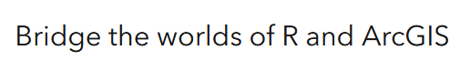

R/ArcGIS Bridge
Provides an R Package for moving spatial data sets between R and ArcGIS Pro.
Allows for R-based geo-processing toolbox creation.
Windows only, sorry!

Slide 23
R/ArcGIS Bridge
Provides an R Package for moving spatial data sets between R and ArcGIS Pro.
Allows for R-based geo-processing toolbox creation.

Slide 24
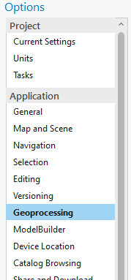
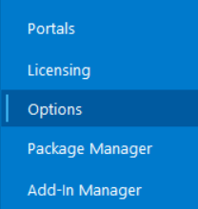
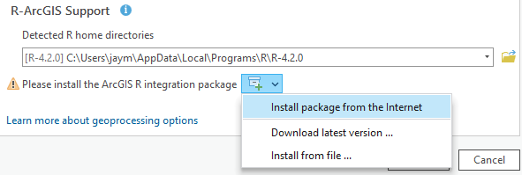
R/ArcGIS Bridge - Install
Open ArcGIS Pro Options.
Select the Geoprocessing tab.
Scroll to R-ArcGIS Support and install.

Slide 25
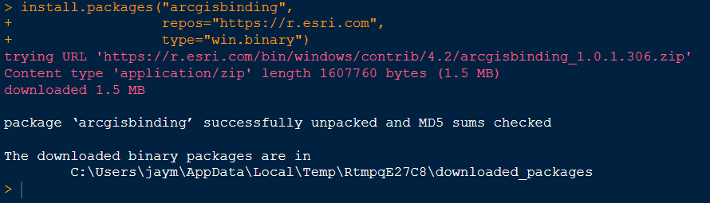
R/ArcGIS Bridge - Install
Install from R via the command:
install.packages("arcgisbinding", repos="https://r.esri.com", type="win.binary")

Slide 26
R/ArcGIS Bridge
arc.open() - Open ArcGIS datasets, tables, rasters and layers
returns arc.dataset-class (not a sf object, not a data frame)
arc.select() – Load a dataset into a standard data frame
arc.write() – Output data to shapefile, geodatabase, raster, more…

Slide 27
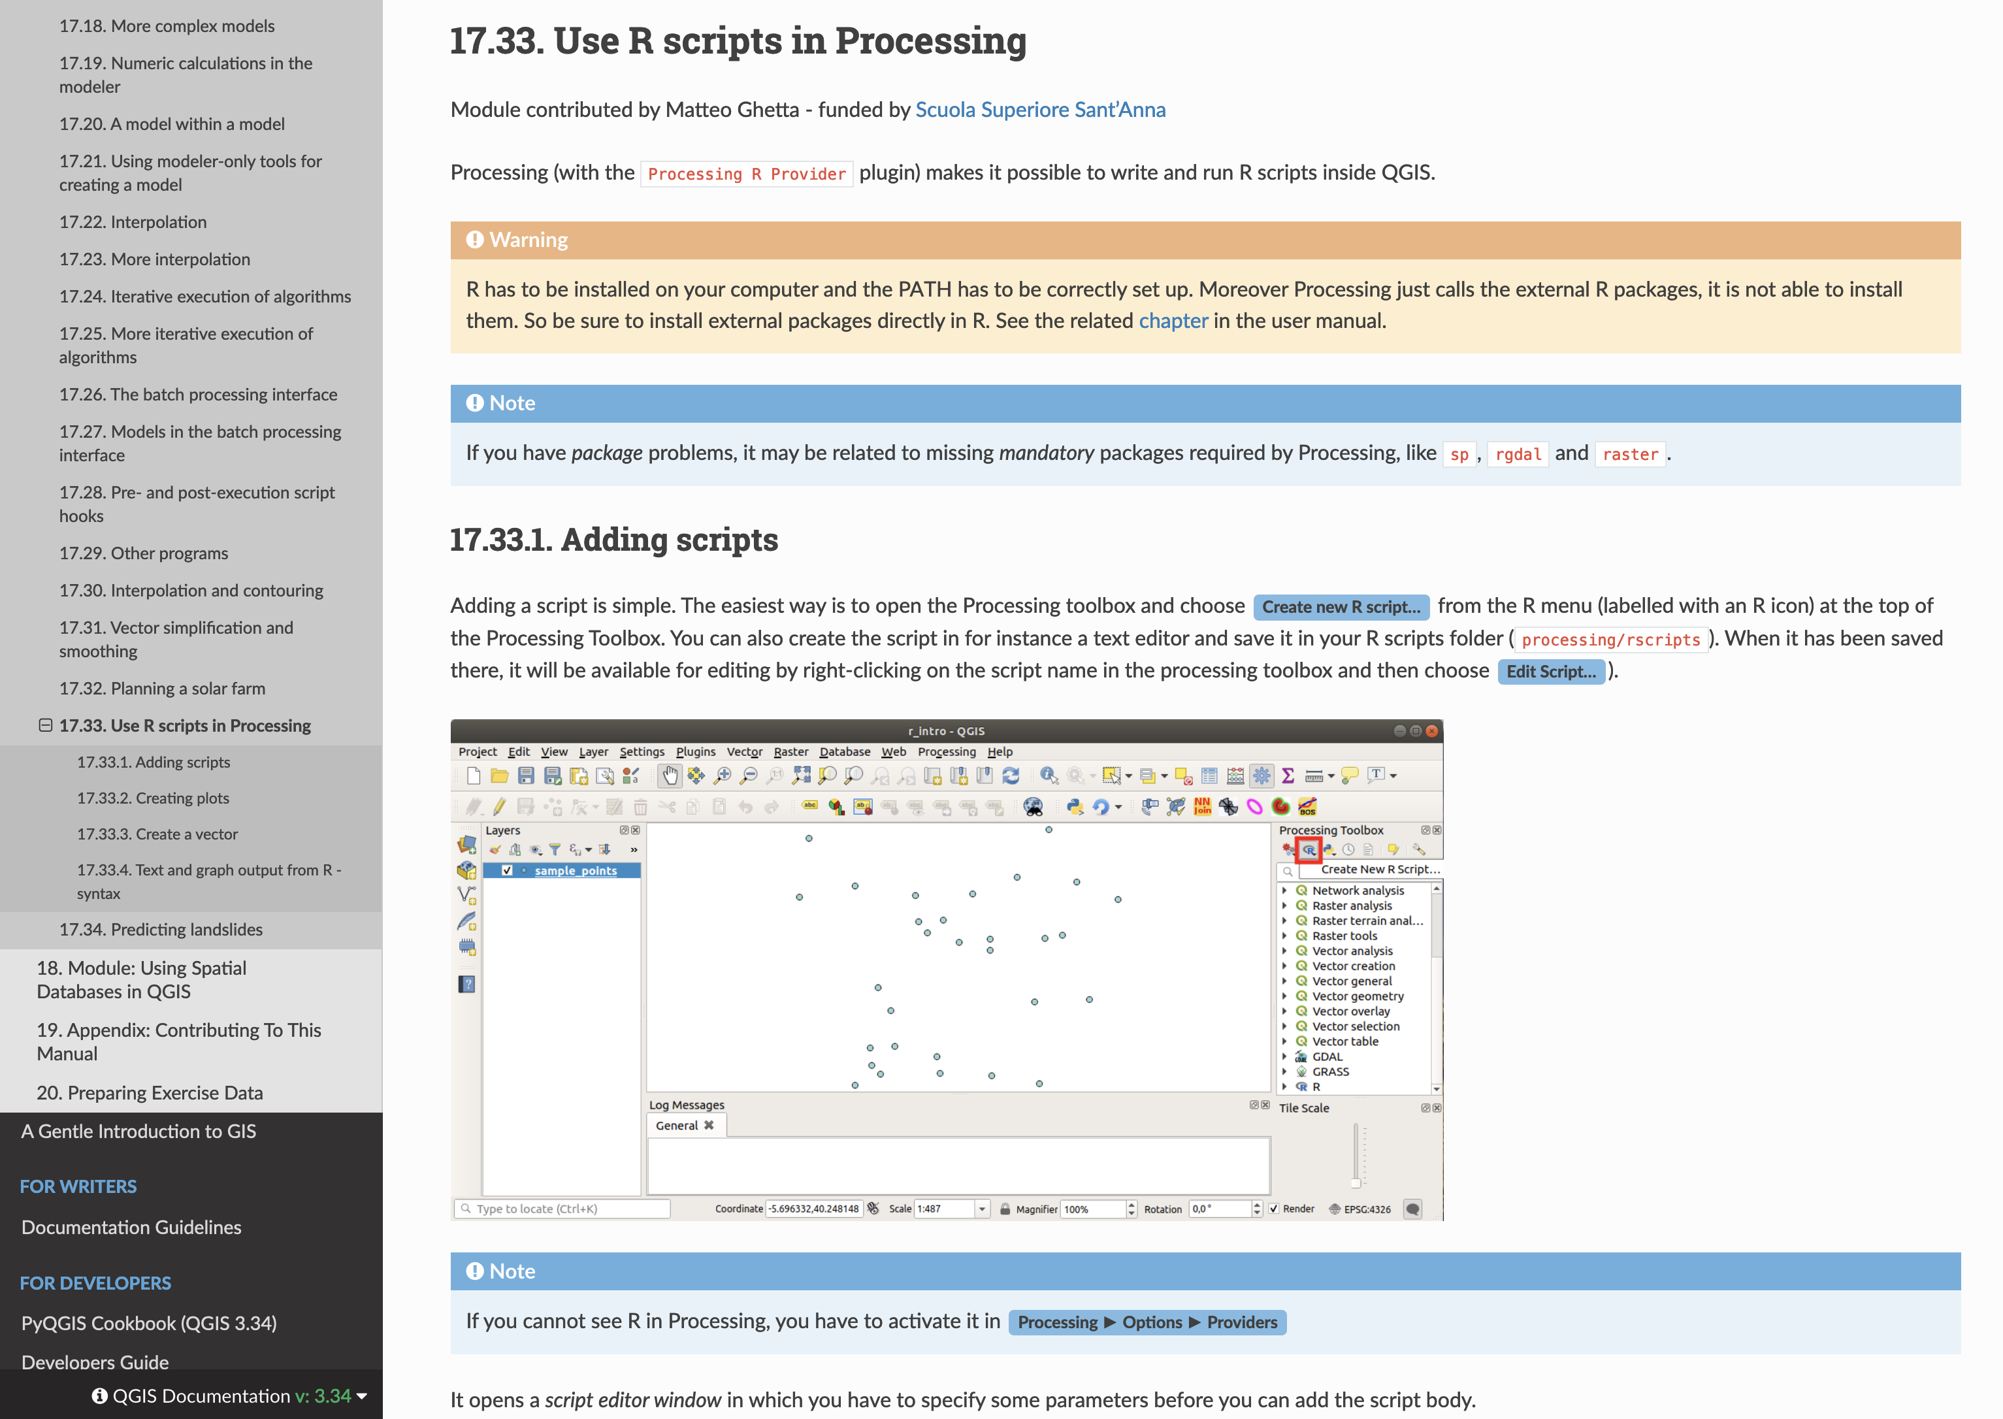
R and QGIS

Slide 28
Code Demo 3
Show ArcGIS Bridge in R
Read & Write to geodatabase

Slide 29
Resources
A list of useful R spatial links and resources used for this presentation.
https://cran.r-project.org/
https://posit.co/download/ rstudio-desktop/
https://www.tidyverse.org/
https://r-spatial.github.io/sf/
https://r4ds.had.co.nz/
https://github.com/R-ArcGIS/
https://r.esri.com/
https://r.geocompx.org/
https://walker-data.com/census-r/
https://github.com/rstudio/cheatsheets/blob/main/sf.pdf

Slide 30
Questions?
This institution is an equal opportunity provider. For the full non-discrimination statement or accommodation inquiries, go to www.extension.iastate.edu/diversity/ext.

Slide 31

Thank You!
Jay Maxwell
jaym@iastate.edu
Chris Seeger
cjs@iastate.edu
Feedback Survey →
This institution is an equal opportunity provider. For the full non-discrimination statement or accommodation inquiries, go to www.extension.iastate.edu/diversity/ext.

